Slide 1
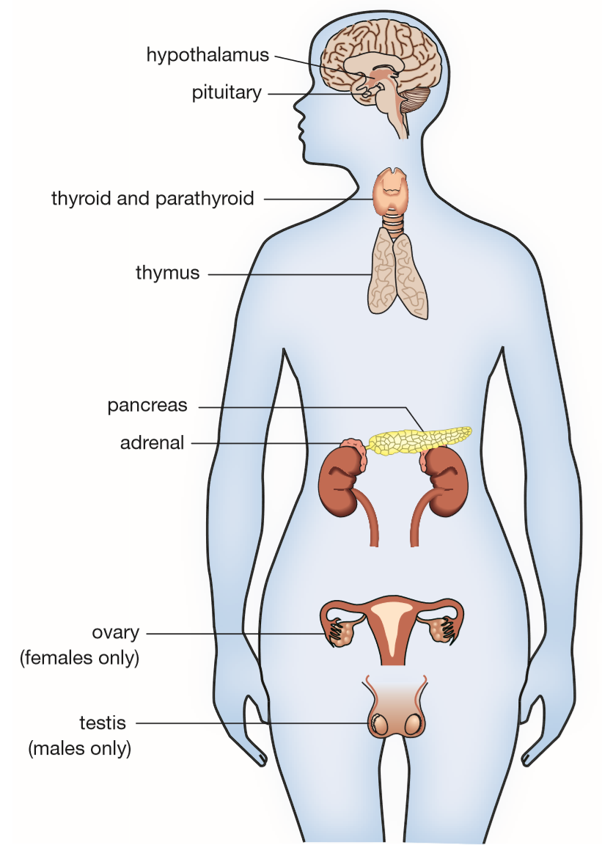
Daily Review
The endocrine system is a collection of glands and organs that secrete hormones into the bloodstream.
Its function is to maintain the body’s internal environment.
List four different endocrine glands in the body.

Slide 2
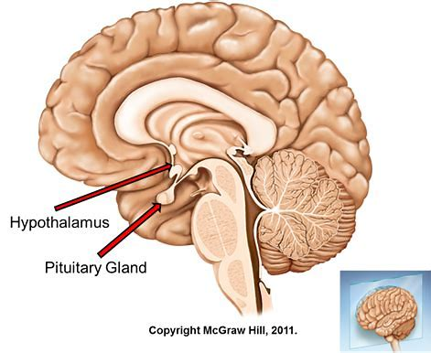
Daily Review
The hypothalamus is a bundle of nerves that links the nervous and endocrine systems.
It monitors the body’s internal environment, i.e. temperature, metabolism, water content.
The hypothalamus secretes hormones to the pituitary gland, which then gives instructions to other glands throughout the body.
Why is the pituitary gland also called the ‘master gland’?

Slide 3
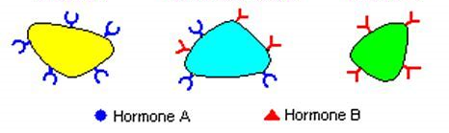
Daily Review
Hormones are specific to their target cells.
They fit together like a lock and key.
Which target cell/s will Hormone A act upon? Explain your choice.
X
Y
Z

Slide 4
Homeostasis
Year 9 Biology

Slide 5
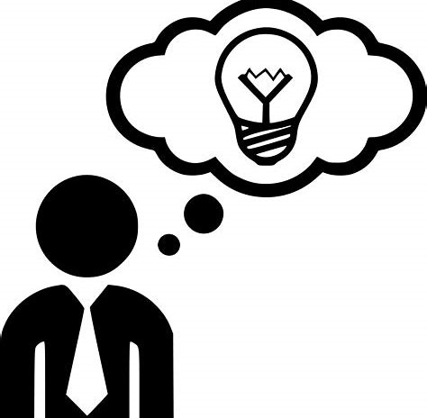
Learning Objectives
CFU
What are we going to learn?
Describe homeostasis.
Explain negative feedback using an example in the endocrine system.
Activate Prior Knowledge
Our body maintains its internal environment, as the brain tells our bodies to change their behaviour.
Think, Pair, Share:
How does your behaviour change when you are:
- Cold?
- Hot?
- Thirsty?
- Feeling dizzy?

Slide 6
Concept Development
Vocabulary
Homeo = same Stasis = stable
CFU 1
What is homeostasis?
Homeostasis
Homeostasis is the process of regulating the internal conditions of the body.
It is the result of the coordination of the nervous system, hormones and organs.
Homeostasis works to control the body’s:
temperature
water and salt content
available energy
available oxygen
concentration of wastes in the blood.
Homeostasis involves receptors that are sensitive to a particular stimulus, and effectors that have an effect on the same stimulus (stimulus-response model).
CFU 2
What three things have to coordinate during homeostasis?

Slide 7
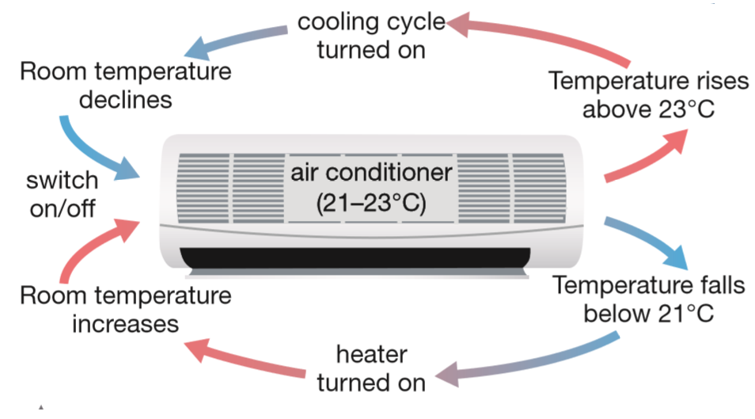
Concept Development
CFU 1
What is the outcome of negative feedback?
CFU 2
Think, Pair, Share: How will the air conditioner respond if the temperature of the room dropped below the optimal range?
Negative Feedback
Negative feedback occurs when the body responds to remove a stimulus.
For example, consider a reverse-cycle air conditioner.
A sensor called a thermostat is set at a particular temperature range, such as 21–23°C.
If the temperature of the room goes above 23°C, the air conditioner switches on and cools the room until the required temperature is reached.
It then switches off.

Slide 8
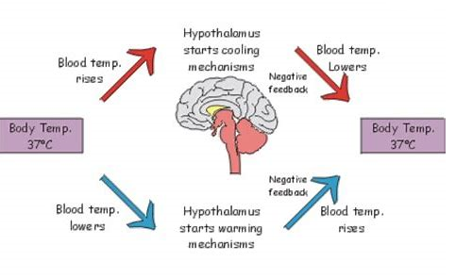
Concept Development
CFU 1
What is normal body temperature?
CFU 2
Think, Pair, Share: How will the body respond to an increase in body temperature?
Negative Feedback in the Body
Normal body temperature sits around 37°C. If body temperature increases or decreases by more than a few degrees, it can be fatal.
To maintain a constant body temperature, several things can happen:
Sweating (perspiration) evaporates water on the skin.
Shivering creates heat in the muscles.
Blood flow is diverted or sent to the skin.
Goose bumps on the skin trap warm air.
Behaviour can also change to increase/decrease body temperature.
CFU 3
Think, Pair, Share: List some behavioural changes to a decrease in body temperature.

Slide 9
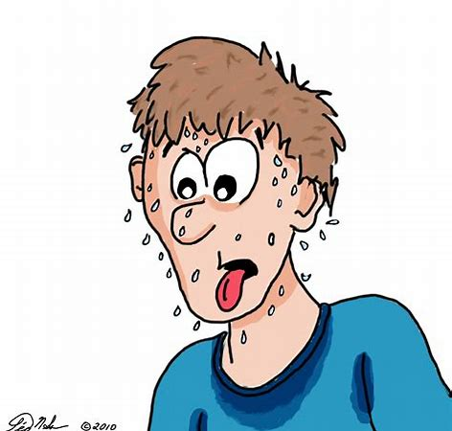
Skill Development/Guided Practice
Negative feedback can be represented in a flowchart, or negative feedback loop, which shows that the original stimulus has been removed.
Describe the negative feedback loop for the body responding to increased body temperature by sweating.
Increase in Body Temperature
Decrease in Body Temperature
Sweating

Slide 10
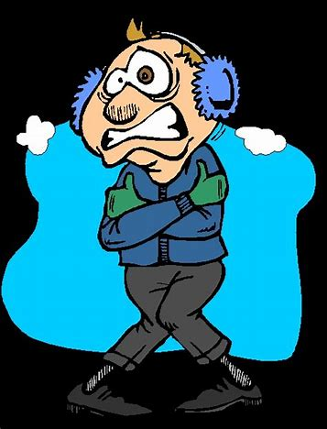
Skill Development/Guided Practice
Reminder
Negative feedback works by removing the original stimulus. It has the opposite effect.
Describe the negative feedback loop for the body responding to decreased body temperature by shivering.
Decrease in Body Temperature
Increase in Body Temperature
Shivering

Slide 11
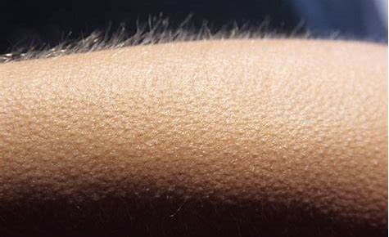
Skill Development/Guided Practice
Reminder
Negative feedback works by removing the original stimulus. It has the opposite effect.
Describe the negative feedback loop for the body responding to decreased body temperature by having goose bumps.
Decrease in Body Temperature
Goosebumps trap warm air next to skin
Increase in Body Temperature

Slide 12
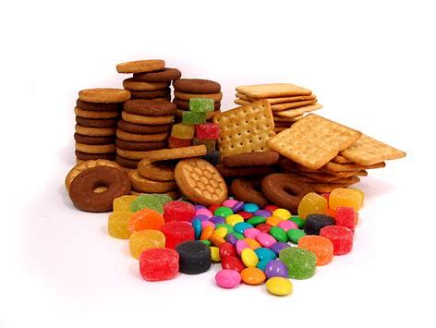
Skill Development/Guided Practice
Reminder
Negative feedback works by removing the original stimulus. It has the opposite effect.
Describe the negative feedback loop for the body responding to low blood sugar (glucose) by eating a sugary snack.
Decrease in Blood Glucose level
Eat a sugary snack
Increase in Blood Glucose level

Slide 13
Relevance
Our bodies are complex organisms that are constantly responding to changes in the external and internal environment.
Knowing about the endocrine system and helps you understand how our body maintains its optimal internal environment.

Slide 14
Skill Closure
What is homeostasis?
Skill Closure
What is the function of negative feedback within the body?
Skill Closure
How is an air conditioner used to explain negative feedback?
Skill Closure
Describe the negative feedback loop for the body responding to a decreased number of red blood cells, by producing more.

Slide 15
Independent Practice
Complete the question on page 57 of the textbook, in your book or device.
Marigold
Rafflesia
Trumpet Vine
Cactus
Jasmine
Bottlebrush

